Slide 1
P U S H
Prevention Utilized for Student Health

Slide 2
Mission
PUSH encourages all members of the community to utilize prevention by enhancing life skills and resilience to prepare youth for the future.

Slide 3
Let’s PUSH mental health awareness
for discussion in schools
Self- Esteem
Decision Making
Risk Taking and Substance Use
Media Influence/Advertising
Managing Emotions
Communication/Social Skills
Resilience
Suicide Awareness
Empathy

Slide 4
PUSH
Encourages students to participate and feel more confident in themselves.
Promotes teamwork, respect, and gives students a sense of belonging.
Creates a caring and positive classroom atmosphere.
Promotes socialization and interaction among students.

Slide 5
PUSH
Encourages students to break out of their comfort zone in a risk-free environment.
Helps students learn that they can count on their peers and create new friendships.
Encourages students to trust their teachers, peers, school staff and most importantly themselves.
Promotes understanding and helps students appreciate differences.

Slide 6
PUSH Week
Monday: Media Influences
Tuesday: Emotions
Wednesday: Risk Taking & Substance Use
Thursday: Communication
Friday: Self- Esteem
Last Week of January

Slide 7
Media Influence
Day 1
Challenge students to leave phone in a safe place for the duration of each class period
Handouts with facts of negative/positive influences of media
Photo backdrop during lunch periods
“How does media influence me…”SnapChat geotag
Discuss how media and advertising can influence youth.

Slide 8
Talk About Emotions
Day 2
“Today I feel…” Sticker
Color coordinate with each grades representing a different emotion
Ex. Seniors- Yellow to represent JOY
Discuss the importance of opening up and talking about our emotions.

Slide 9
What risk are you willing to take?
Day 3
Real life scenarios
Each teacher receives a story and hands out a character to each student
Handouts to help students understand different types of risks
Show Untitled-Simple Plan music video
Discuss the difference of negative (a threat) and positive (an opportunity) risk taking.

Slide 10
Communication is key
Day 4
Learn how to communicate assertively
Challenge students to communicate with their peers, teachers, and loved ones
Challenge students to sit with someone different for lunch, meet someone new and learn 3 things about them ect.
Friend compatibility test
Verbal vs. Non Verbal
Discuss how important communication is in all aspects of life.

Slide 11
Self-Esteem
Day 5
Compliment grams
Positive Affirmations around the school (Bathrooms, classrooms, hallways, computer labs, ect.)
Discuss the importance of self love and boosting students self esteem.

Slide 12
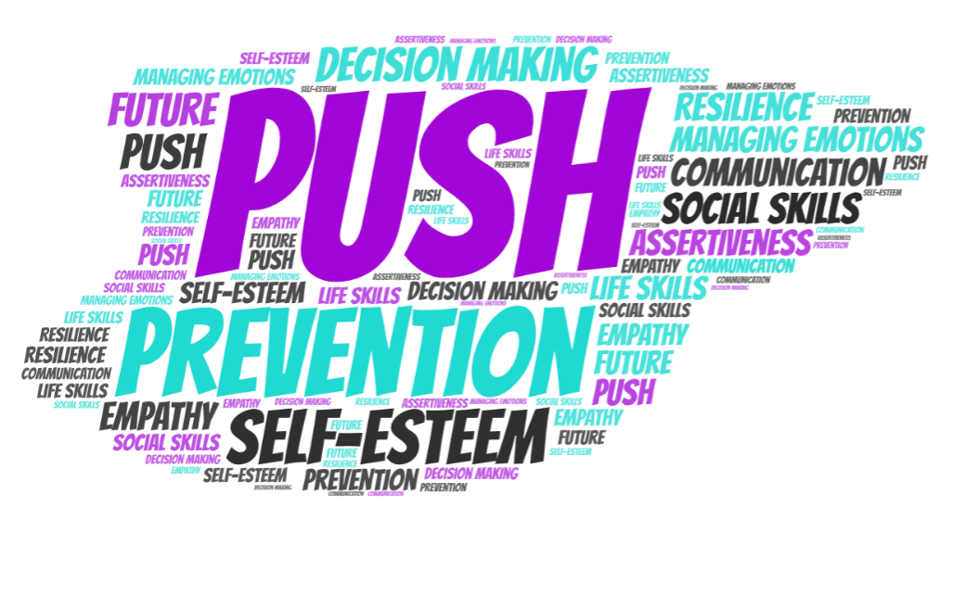
“PUSH harder than yesterday for a better tomorrow. ”

